Slide 1
NEWS HEADLINE CLUSTERING
GROUP 12 -
PRADNYA CHAUDHARI (405119)
JYOSTNA SONAWANE (405135)
POOJA PATIL (405178)
RICHA PATEL (405105)

Slide 2

LP- 2
PART A - Data Mining
ASSIGNMENTS:
Write Java/Python code for simple implementation of K-means clustering algorithm.
Implement Apriori approach for data mining to organize data items on shelf using given table using Java/Python.
Implement Naive Bayes for concurrent application. Approach should handle categorical and continuous data using Java/Python.
Consider a suitable text dataset. Remove stopwords, apply stemming and feature selection techniques to represent documents as vectors.

Slide 3
Write Java/Python code for simple implementation of K-means clustering algorithm.
--
https://drive.google.com/open?id=1mP8Fd9eFUpPQ086o6hZKukw0g7S8II4I

Slide 4
Implement Apriori approach for data mining to organize data items on shelf using given table using Java/Python.
--
https://drive.google.com/open?id=1wGuDxmoqCIOQD003rPMvThLSpekES4tl

Slide 5
Implement Naive Bayes for concurrent application. Approach should handle categorical and continuous data using Java/Python.
--
https://drive.google.com/open?id=1Zfu32RLrwhsYhk1o_cOvXjcCKn-rq05b

Slide 6
Consider a suitable text dataset. Remove stopwords, apply stemming and feature selection techniques to represent documents as vectors.
--
https://drive.google.com/open?id=1JYGXhNNMB41SqyDF-OQAxNJxvfiyxWrF

Slide 7
LP - 2
PART B : Software Testing and Quality Assuarance.
ASSIGNMENTS:
To study different types of software testing techniques with reference to software testing and quality assurance
To study and perform Unit Testing using testing tool JUnit.
Study and implementation of integration testing for implementation of software project in python/java
To study web based testing using Selenium.

Slide 8
To study different types of software testing techniques with reference to software testing and quality assurance
https://drive.google.com/open?id=1dlfSvAemLRxSb1mIQw8jKRvuTgAgNTwR

Slide 9
To study and perform Unit Testing using python library unittest.
https://drive.google.com/open?id=1Gk2mftillvuU3AFN-5M5Ri9_mueMHDdP

Slide 10
Study and implementation of integration testing for implementation of software project in python/java
https://drive.google.com/open?id=1-zInRv4dERS8ULFpQCJg1nlSlfIJmeAi

Slide 11
To study web based testing using Selenium.
https://drive.google.com/open?id=1561xYzq4Z_1O-xG9r2nRec5ttC9K6UWe

Slide 12
NEWS HEADLINE CLUSTERING

Slide 13

INTRODUCTION
News articles published on different news portals throughout the web are the sources of the information. These can also be very good topics for the research on text mining. Clustering of similar news headlines and putting them under a single platform can be a very efficient option to the exploration of the same news article across multiple different news portals, which is a tedious and time-consuming task.

Slide 14
PROBLEM DEFINITION
The project aims to groupvarious news articles under various categories and represent it using clusters. The goal is to analyze raw data of news headlines, process it and determine various categories of news posted over a period of time.

Slide 15
SCOPE STATEMENT
The scope of the project is to find similarity between various news headlines and group them accordingly. Clustering news which was obtained over a certain period of time provides researches and a broader view and understanding of type of incidents which majorly dominated the year, ex: 2019 was all about the Cricket World Cup and Elections.

Slide 16
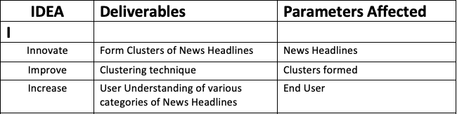
IDEA MATRIX - I

Slide 17
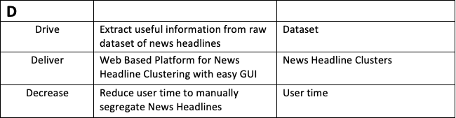
IDEA MATRIX - D

Slide 18
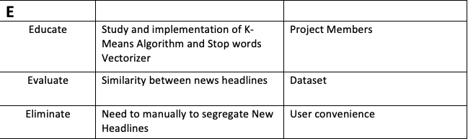
IDEA MATRIX - E

Slide 19
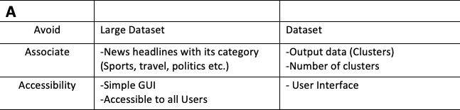
IDEA MATRIX - A

Slide 20
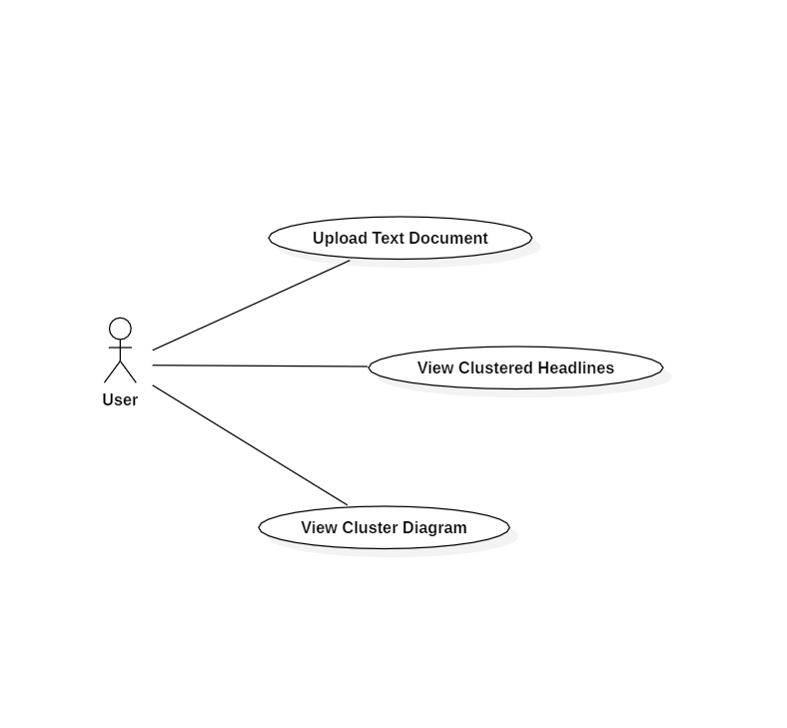
UML
Use Case Diagram

Slide 21
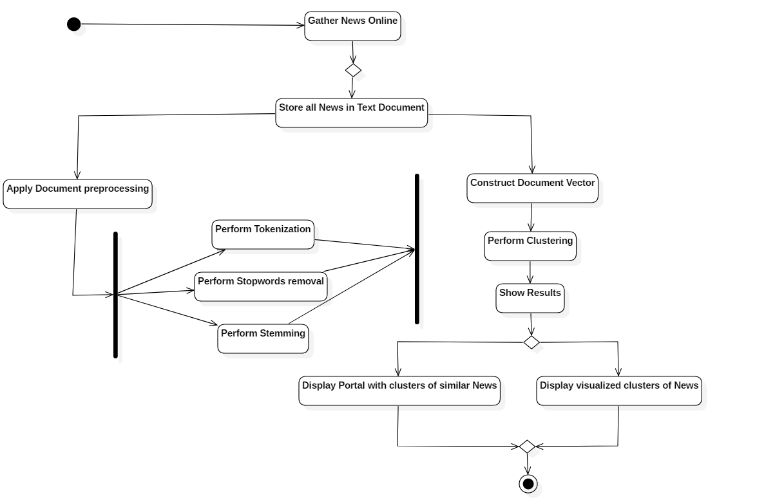
UML
Activity Diagram

Slide 22

GUI

Slide 23
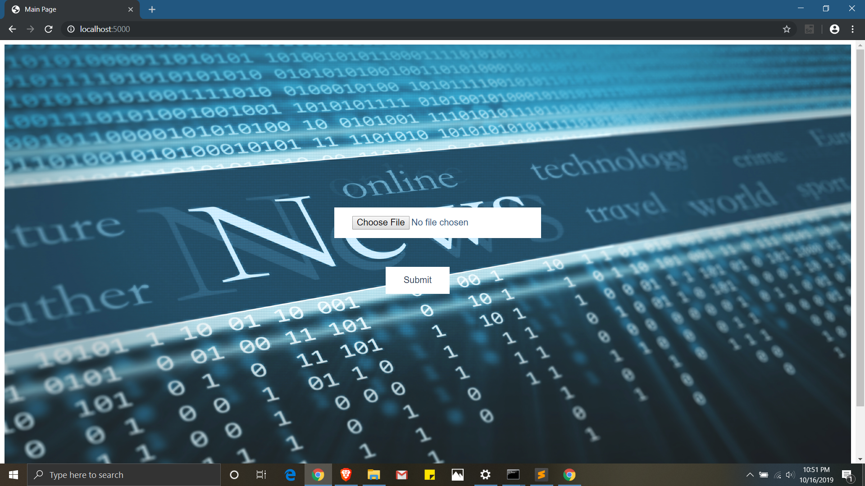
GUI - HOME PAGE

Slide 24
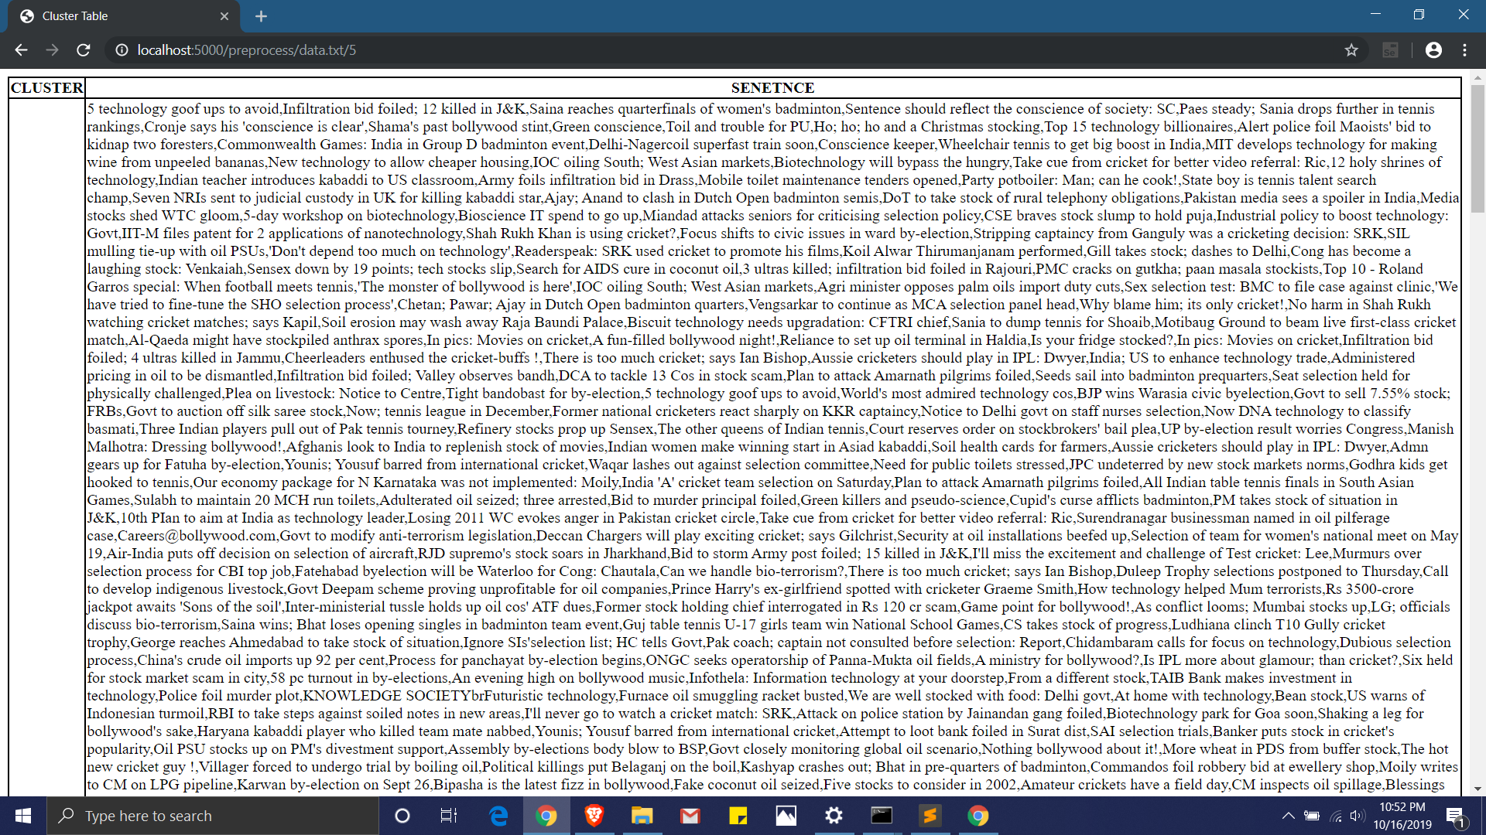
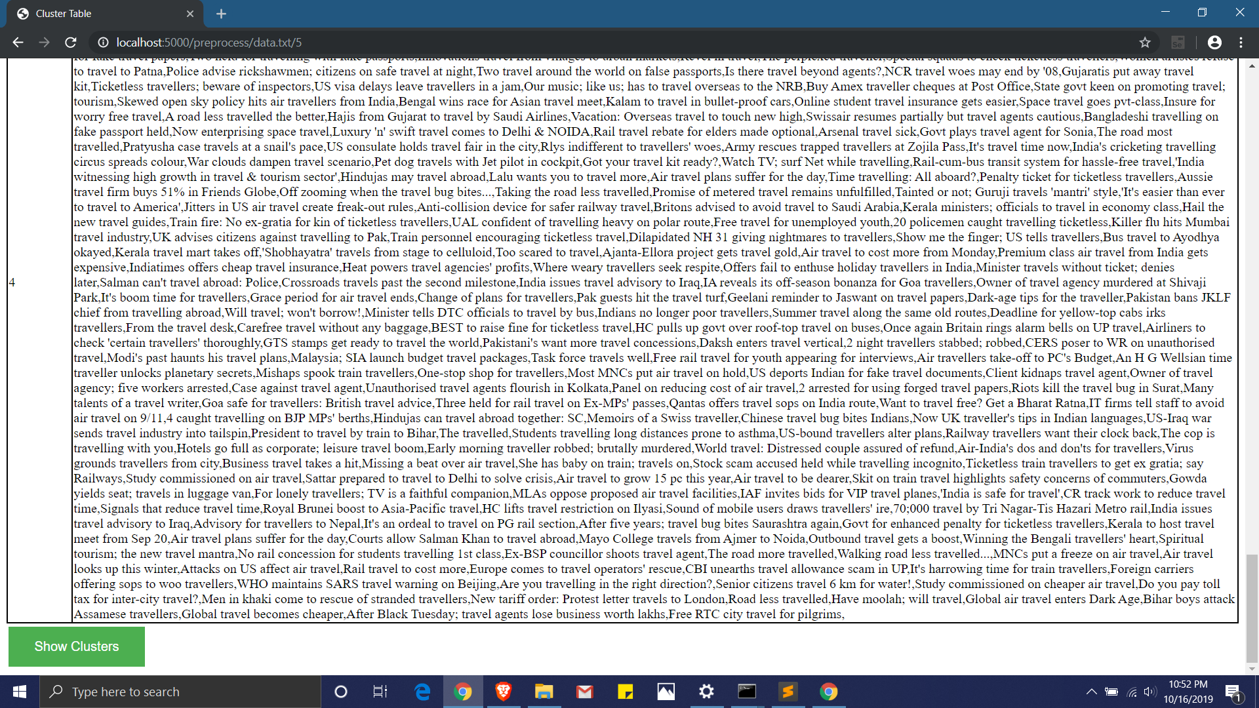
GUI - TABLE

Slide 25
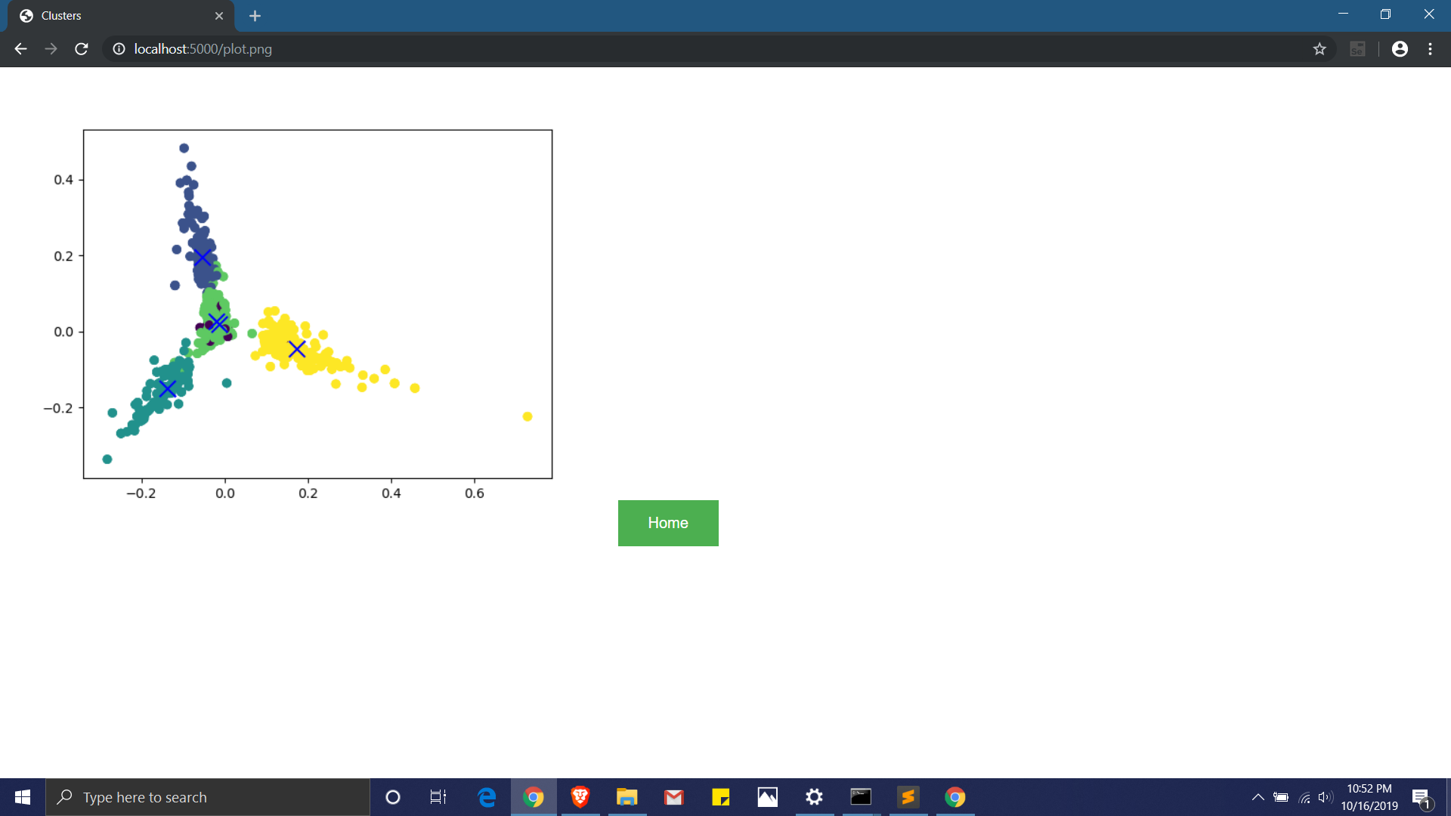
GUI - DATA VISUALIZATION

Slide 26
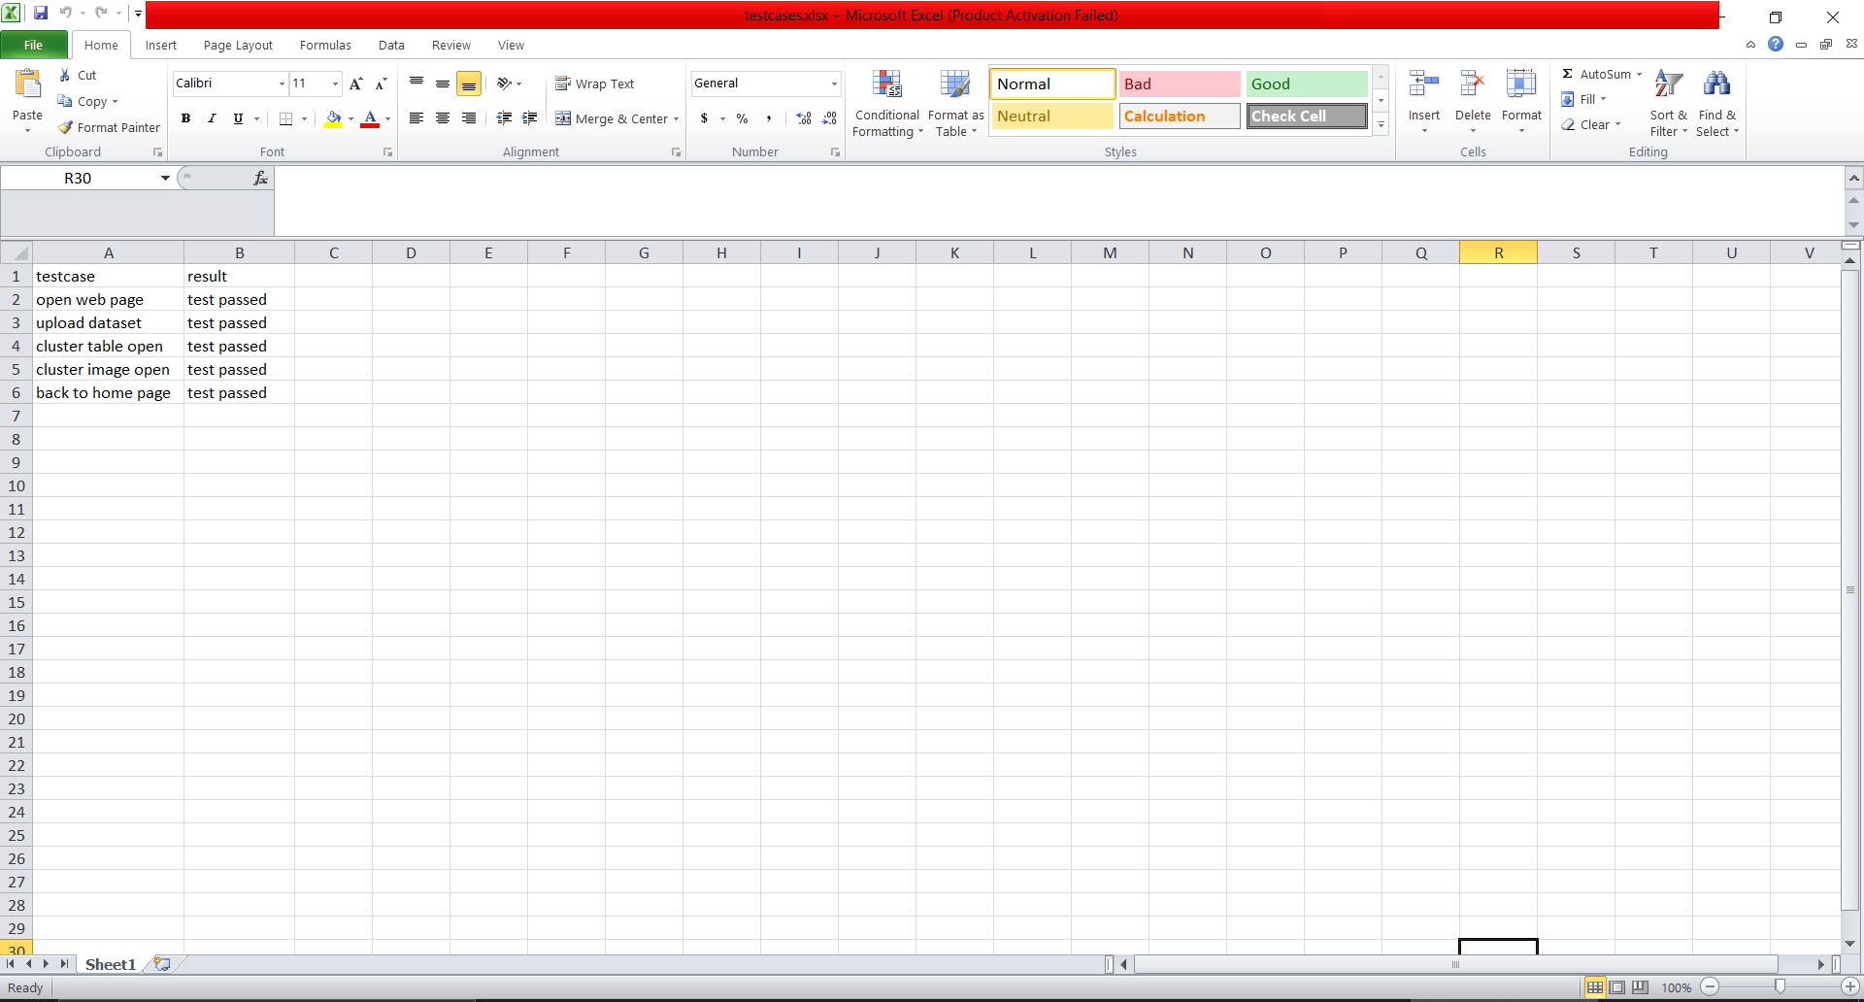
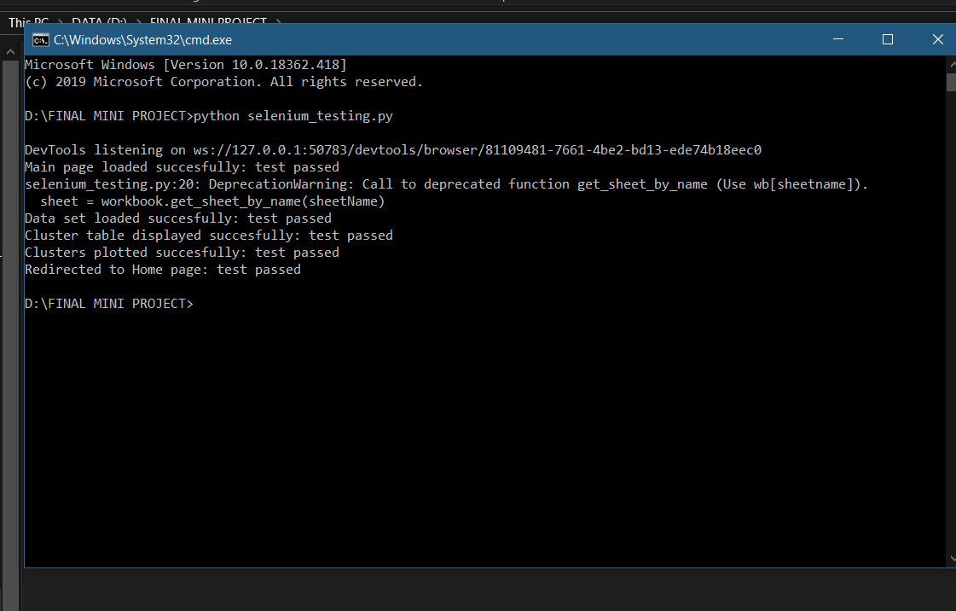
TESTING – SELENIUM AUTOMATION TESTING

Slide 27
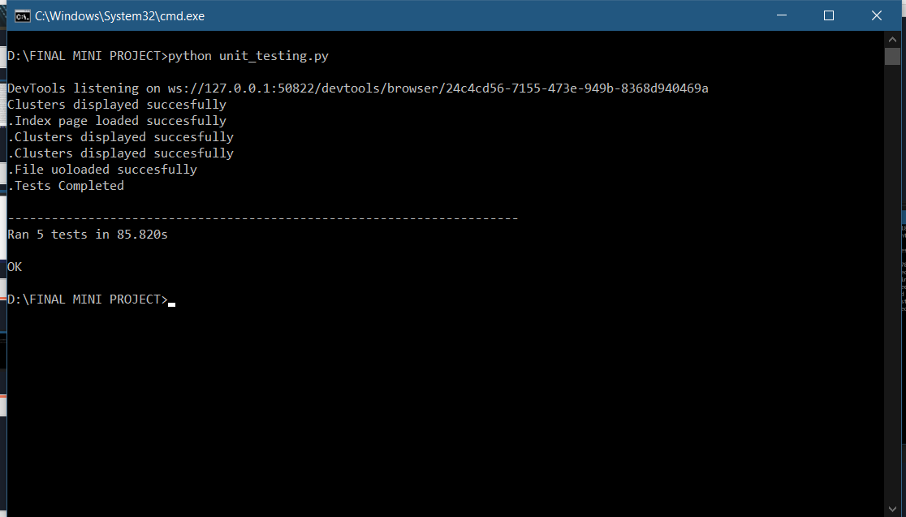
TESTING – UNIT TESTING

Slide 28
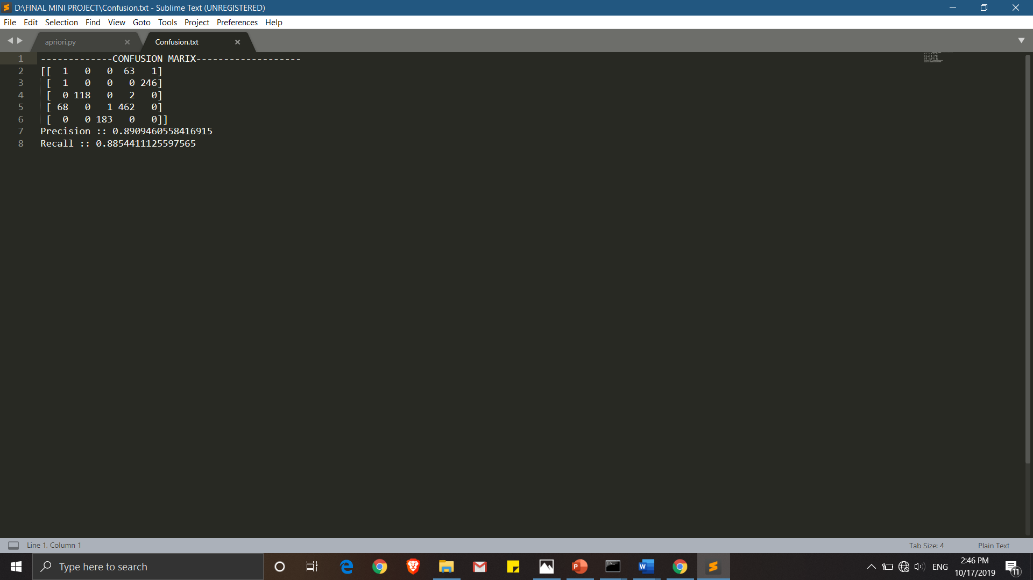
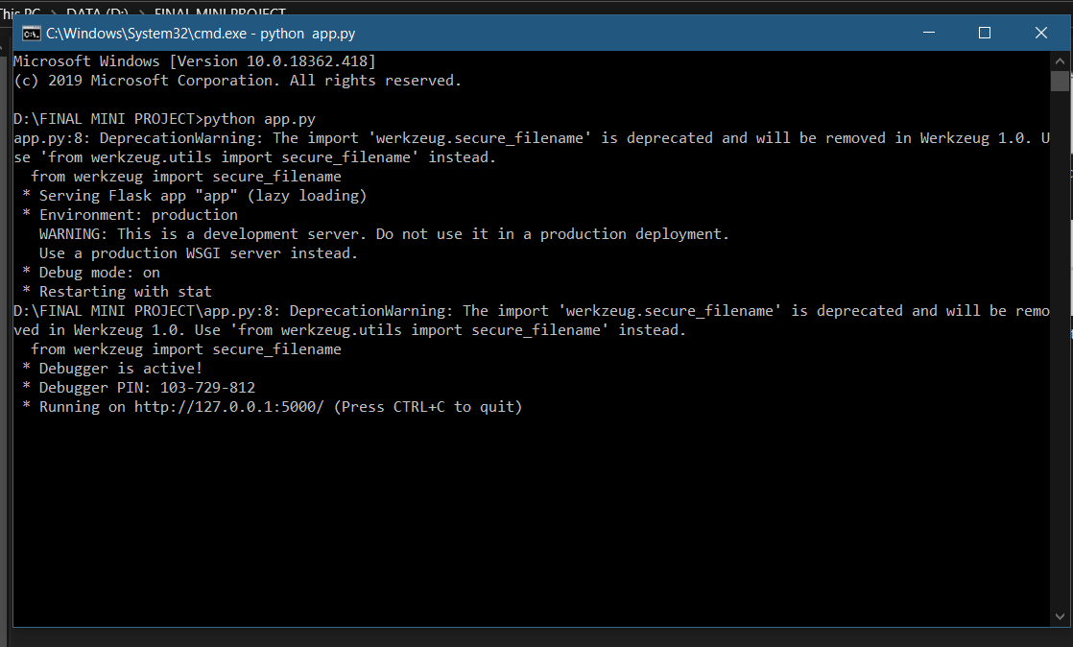
CONFUSION MATRIX AND PRECISION AND RECALL

Slide 29

CONCLUSION - We have successfully formed clusters of various categories of News Headlines using K-Means Clustering Algorithm.

